Slide 1
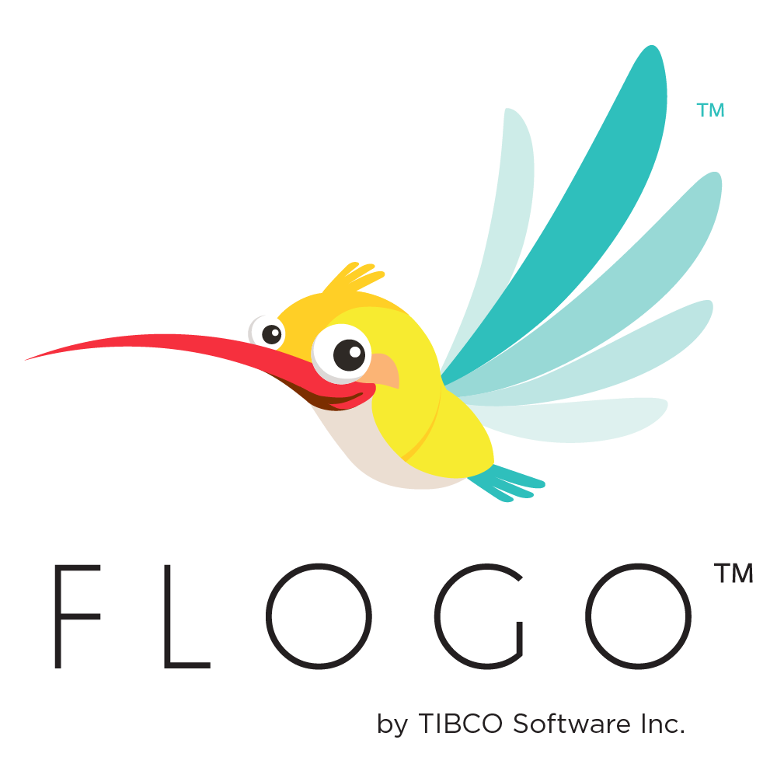
TIBCO FLOGO
Training Day 2
Trainer: Jaydeep
Date: 06/Jul/2023

Slide 2
Agenda
1.Develop TIBCO Flogo® Apps
Flogo® Apps
Triggers
Flows
Activity
Flow Tester
Launch Configurations
Flow Testing using CLI
Features
App Import/Export
TCI API
2.Develop with TIBCO Cloud™ Integration(LAB)

Slide 3
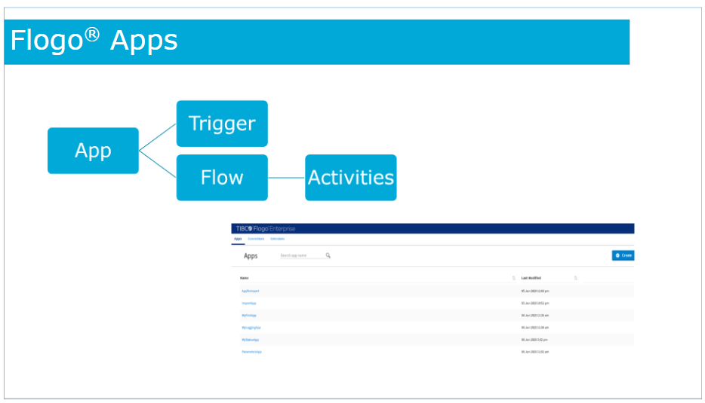
Flogo Apps
Flogo apps are developed as event-driven apps using triggers and actions and contain the logic to process incoming events.
A Flogo app consists of one or more triggers and one or more actions such as flows.

Slide 4
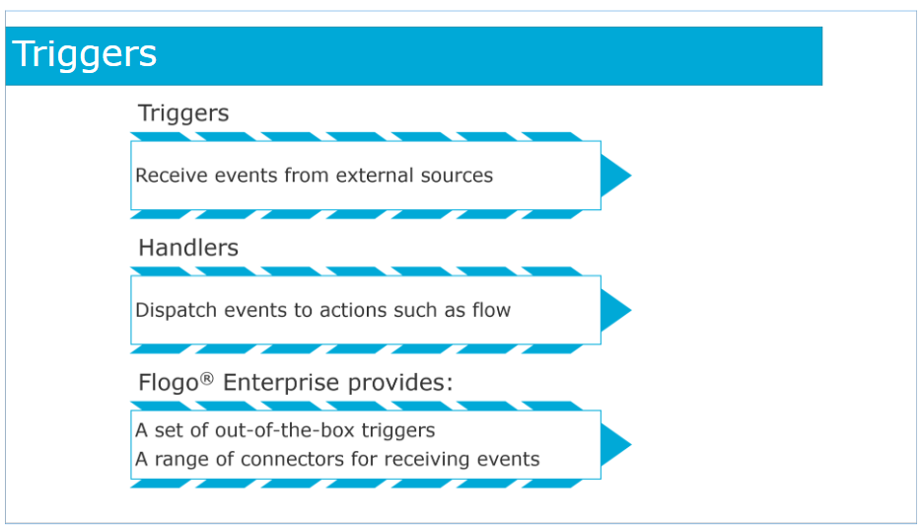
Triggers
Triggers receive events from external sources such as Kafka, Salesforce, GraphQL and so on.
Handlers dispatch events to actions such as flow. Flogo provides a set of out-of-the-box triggers as well as a range of connectors for receiving events from a variety of external systems.

Slide 5
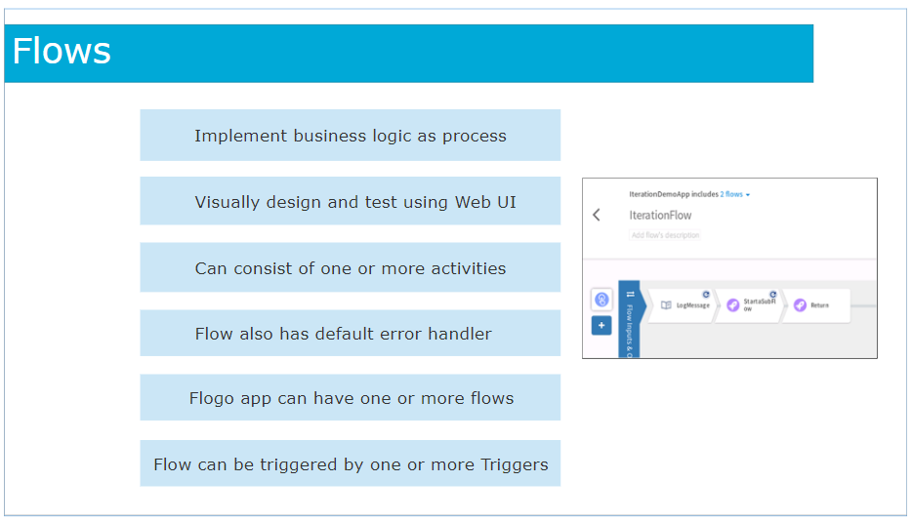
FLOW
The Flogo ecosystem provides a set of actions for processing events in a manner suitable to your implementation logic.
The flow is one of the actions in Flogo that allows you to implement the business logic as a process.
Flows are visually designed and tested using the Web UI.
A flow can consist of one or more activities that perform a specific task.
Activities are linked and can contain conditional logic for branching.
Each flow also has a default error handler.
A Flogo app can have one or more flows.
A flow can be triggered by one or more Triggers within the application.

Slide 6
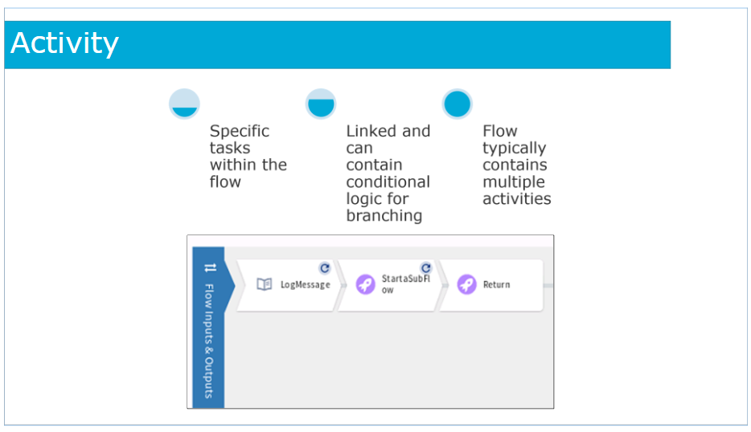
Activity
Activities perform specific tasks within the flow.
Activities are linked and can contain conditional logic for branching.
A flow typically contains multiple activities.

Slide 7
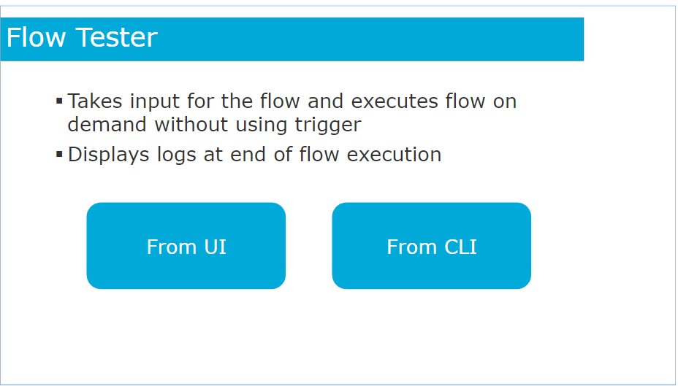
Flow Tester
When designing a flow, runtime errors can go undetected until you build the app to execute the flow. It can become particularly cumbersome to test flows that start with a trigger, which activates based on an external event, because you need to configure the external application to send a message to the trigger in order to activate the trigger and consequently execute the flow.
Using the Flow Tester, you do not need to activate the trigger to execute the flow.
The Flow tester takes the input for the flow and executes the flow on demand without using the trigger.
Each activity executes independently and displays its logs at the end of the flow execution. This lets you detect errors in the flow upfront without actually building the app.
You can use the Flow Tester from the Flogo Enterprise Web UI or you can use the CLI to run the test command in the Flow Tester.

Slide 8
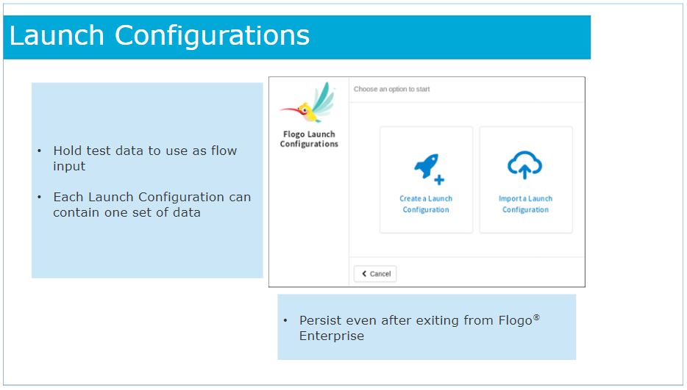
Launch Configuration
Create a Launch Configuration to hold test data that you want to use as input to the flow. Launch Configurations allow you to save and use your input data without having to enter it every time you want to test or retest the flow.
Launch Configurations are particularly useful when you want to test the flow multiple times with complex data or multiple sets of data.
Create a Launch Configuration once with the data and use the Launch Configuration as input to the flow instead of manually entering the data every time you execute the flow.
You can create multiple Launch Configurations, each containing a different set of data.
A Launch Configuration can contain only one set of data.

Slide 9
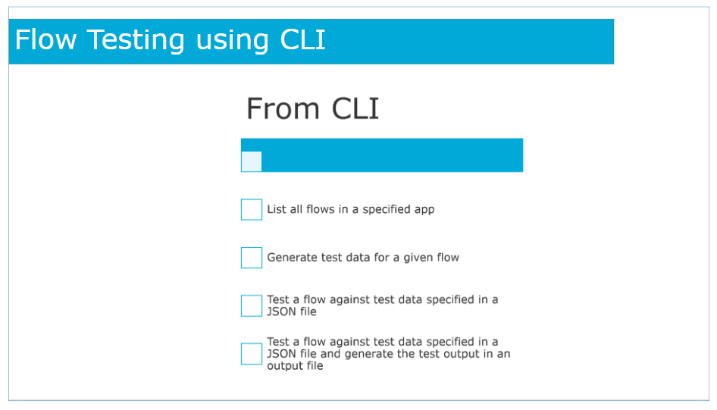
Flow Testing using CLI
This feature allows you to test your Flogo app using the Flogo app itself. Once you have built the binary for a Flogo app, you can test it using the test command. This feature is also useful to automate the testing process for a flow.
You can do the following from the CLI:
List all flows in a specified app.
Generate test data for a given flow.
Test a flow against test data you specify in a JSON file.
Test a flow against test data you specify in a JSON file and generate the output of the test in an output file that you specify.

Slide 10
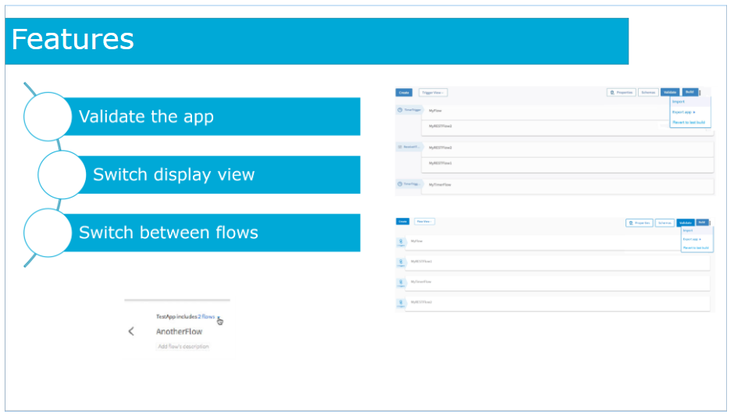
Features
After you have created the flows in your app, you must validate the app before you push it to the cloud.
To validate your app, click the Validate button on the app details page. This validates each flow and activity.
If a flow or activity has an error, it displays an error or warning icon on the flow or activity.
Flogo Enterprise does not retain the results of the previous validation if you navigate into a flow after you have validated the app.
When you click an app on the Apps page, the app details page opens. The flows in the app are listed in the app details page.
You have the option to view this page from a Trigger View or Flow View. By default, it opens in the Trigger View.
If an app has multiple flows, you can switch between the flows within an app.

Slide 11
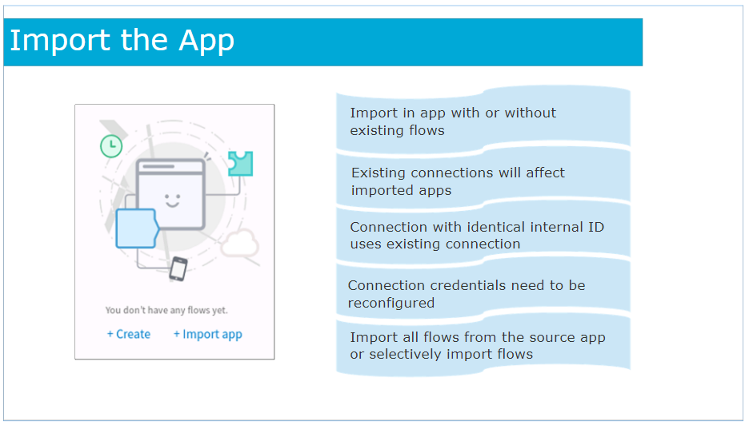
Import App
You can import in an app with or without existing flows.
When importing an app containing a connection, if you have an existing connection with an identical internal ID as the connection in the app being imported, a new connection does not get created.
The imported app uses the existing connection in such a case.
However, since the connection credentials do not get exported with the app, if a new connection gets created, you must re-configure the connection credentials after the app has been imported.
You can import all flows/triggers from the source app or selectively import them

Slide 12
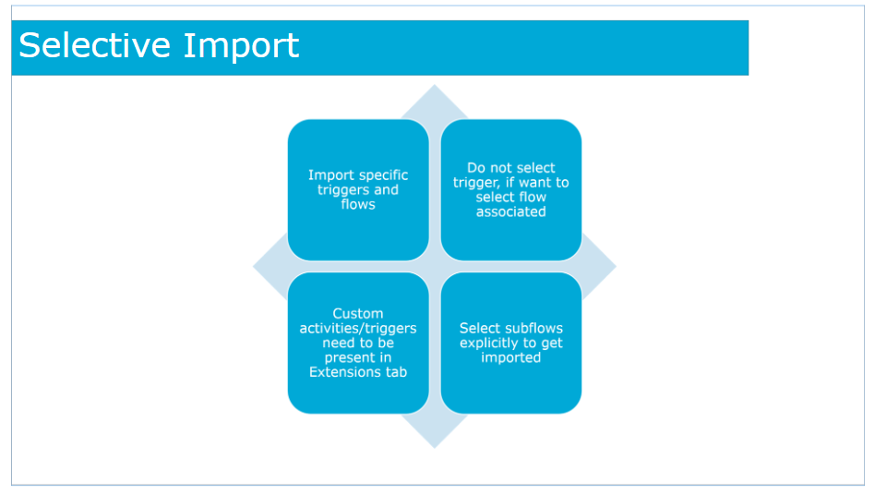
Import App
Select Selective Import, to import only specific triggers and flows from the app. The Import app dialog displays a list of triggers with a check box next to each one.
The activities/triggers missing in the Extensions tab are not listed in the Import app dialog, hence you will not be able to select them to import. By default, all check boxes are selected. Clear the check box next to the triggers that you do not want to import.
By default, all flows associated with the selected trigger(s) get imported. If you do not select a trigger, the flows and their subflows associated with the unselected trigger(s) are listed in the next screen.
If you had not selected a trigger in the previous dialog, the flows associated with that trigger are displayed. You have the option to select one or more of these flows such that the flows get imported as blank flows that are not attached to any trigger. By default, all flows are selected. Clear the check box for the flows that you do not want to import. If your flow(s) have subflows, and you select only the main flow but do not select the subflow, the main flow gets imported without the subflow.

Slide 13
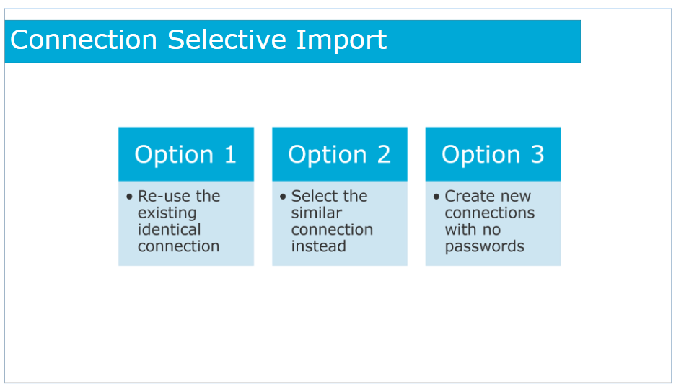
Import App
Each connection in Flogo® contains a unique internal ID. The IDs are not exposed in the Web UI and are unique based on the user who created them.
When Flogo® Enterprise compares connections, it does so by comparing their internal IDs. It considers two connections identical if they have the same connection type and same connection ID. It considers two connections as similar, if they have the same connection type, but different connection ID.
Hence, if the app you are importing was not created by you, then any connections used in that app can not have the same ID as any existing connection of the same type that you might already have in your installation of Flogo®.
If you chose to do a selective import when importing an app, the Import app dialog lists the connections that are used in the flows and triggers that you selected for import in the app to be imported. It displays a drop-down menu next to each connection. You have the following options:
If you have any existing identical connections (same connection type and same connection ID) in the host app, that connection will automatically be selected in the drop-down menu next to the connection. You have the option to re-use the existing identical connection.
If there are any similar connections in the host app (same connection type but different connection ID), you can select the similar connection instead from the drop-down menu next to it.
You always have the option to select Create new connection from the drop-down menus for any of the connections. Flogo® Enterprise creates new connections with no passwords. You must manually create a password for the new connection after importing the app.

Slide 14
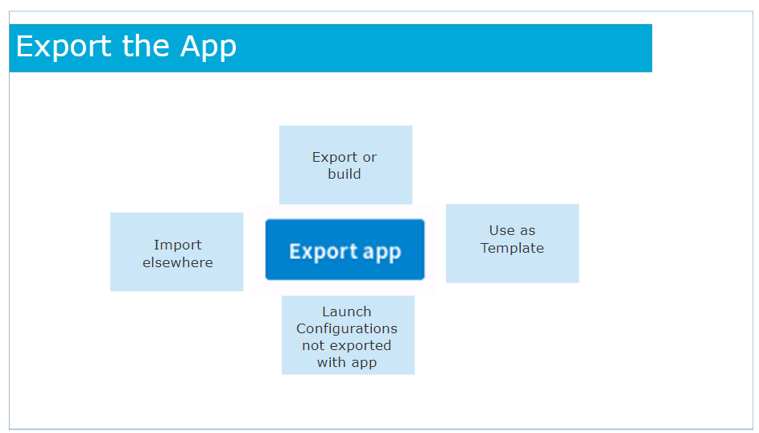
Export App
After you have created your app, you have the option to export the app . Exporting an app allows you to import it elsewhere, for example in TIBCO Cloud™ Integration.
You can export and import apps and use them as templates to quick start development or simply put them in a version control system such as GitHub.
When exporting an app, if the app contains Launch Configurations to hold its test data, the Launch Configurations will not be exported with the app.
Launch Configurations in an app will need to be exported independent of the app export.

Slide 15
App Import/Export Tips
Exporting apply to all flows within your app. You cannot pick and choose flows to export.
If any flow in the app uses extensions developed by the community, you need to make sure that those extensions are available to the app into which you are importing when importing. Flows that make use of extensions that are not present will not be imported.
Passwords configured in any activity within any flow or connection in the app to be exported will be stripped out in the exported app. You must manually configure the credentials in the flows after importing such apps.
Some apps created in Project Flogo™ use the any data type. The any data type is not supported in Flogo Enterprise. Such apps get imported successfully, but the element of type any gets converted into an empty object. You must explicitly use the mapper to populate the empty object with member elements.
When importing an app, be aware that the long and double data types get converted to the number data type.

Slide 16
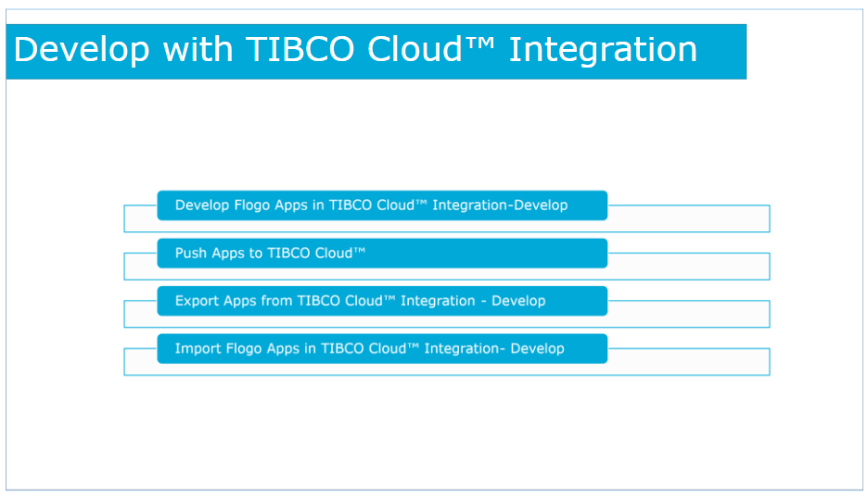
Develop with TIBCO Cloud™Integration(LAB)
TIBCO Cloud™ Integration - Develop provides capabilities to develop the flogo apps and to push the apps to Tibco cloud.
Also you can export/ import the app and can use in Tibco Cloud Integration – Develop.

Slide 17
TCI API
1. Create Oauth access token
2. Enable API for organization
https://api.cloud.tibco.com/tci/docs/#/Organization/enablePlatformAPI
Use the POST ​/v1​/subscriptions​/{subscriptionLocator}​/apiservice​/acces method to enable API access for any organizations you wish to access and manage using the API.
3.https://api.cloud.tibco.com/tci/docs/#/Apps/exportApp
4.https://api.cloud.tibco.com/tci/docs/#/Apps/copyApp

Slide 18
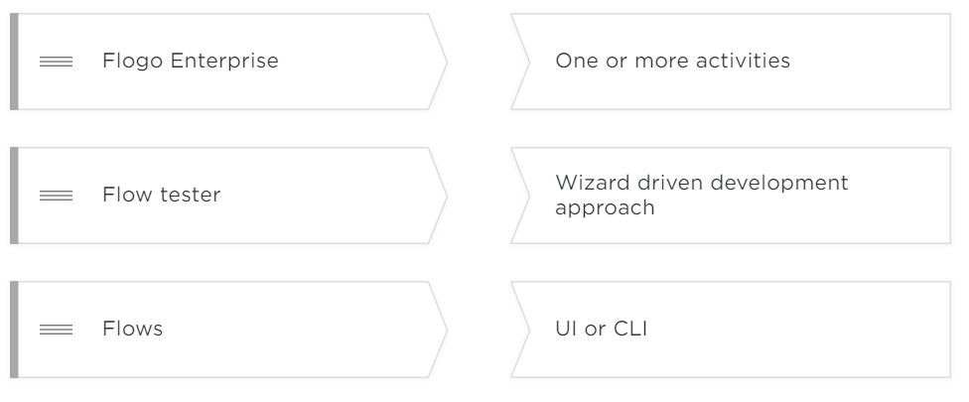
Check Your Knowledge

Slide 19
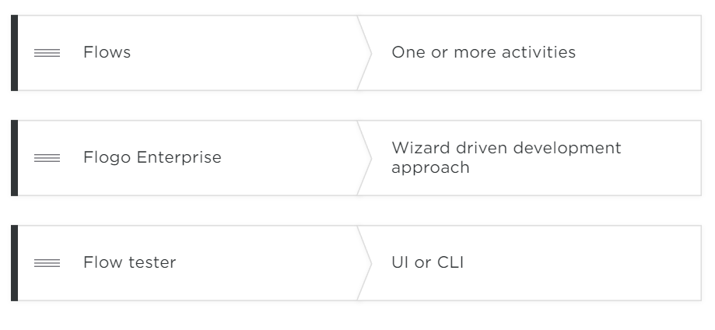

Slide 20
Questions?

